Slide 1
Software Management
Suyash Shrestha

Slide 2
Content
General discussion about coding
Collaborative coding using Git
Summary and examples

Slide 3
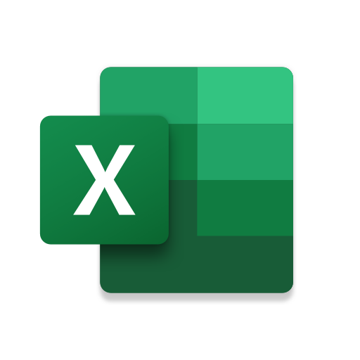






General discussion about coding
Alternative to coding
Python 3
IDEs:
Visual Studio 2017
Visual Studio code
Spyder
IDLE
Notes:
switch from python 2 to python 3 ---> https://learntocodewith.me/programming/python/python-2-vs-python-3/

Slide 4
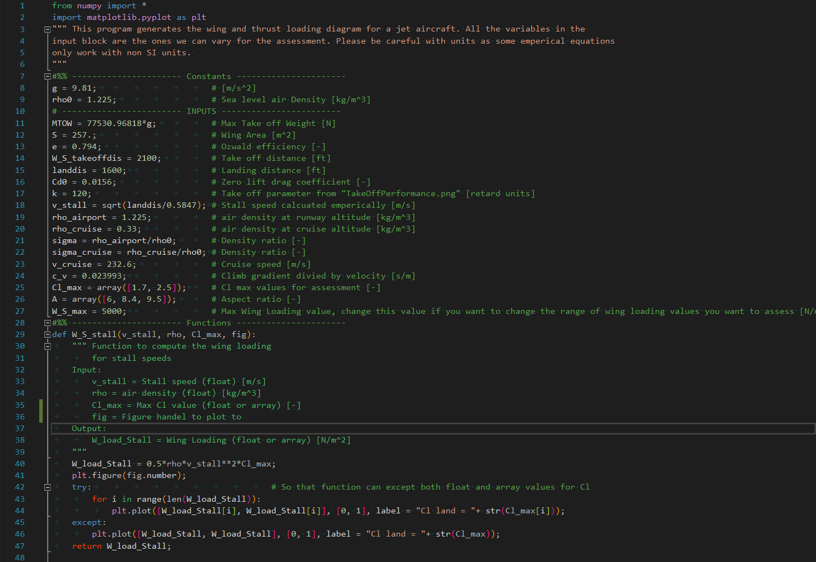
General discussion about coding
Commenting your code

Slide 5
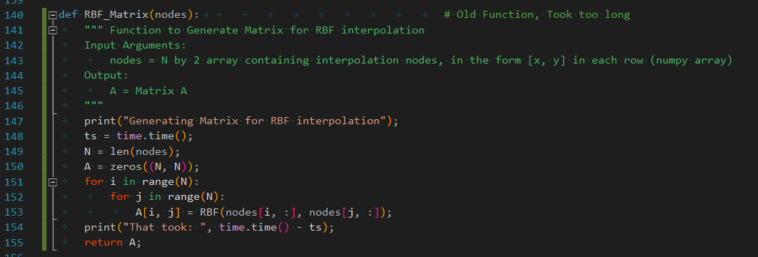

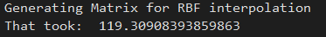
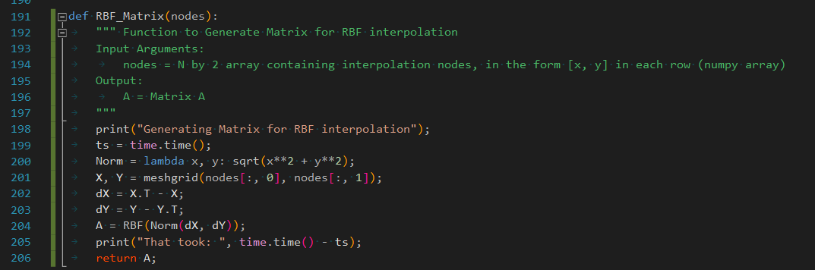
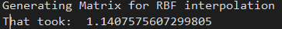
General discussion about coding
Tips for coding:
Logical variable names
Vector and matrix based operations
avoid making empty lists

Slide 6

Collaborative Coding
Group division
Git and Github
Git → Version Control System
Github → Online Service
Notes:
https://www.youtube.com/watch?v=aOgh5uUqcgc&t=61s you’ll thank me later XD

Slide 7

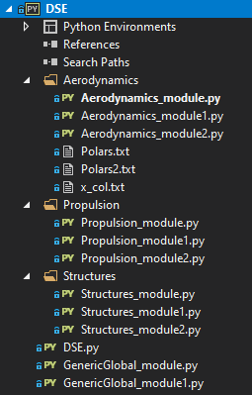
Collaborative Coding
Repos organization
Adding .py files and folders
Deleting done only by me!!

Slide 8
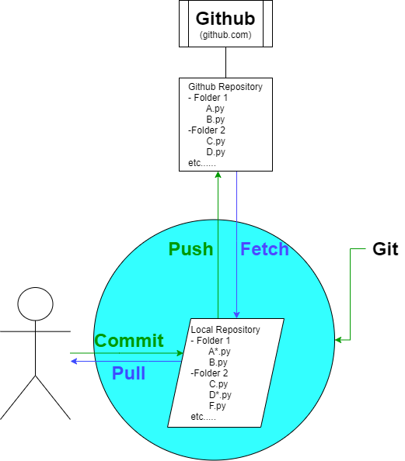
Collaborative Coding
How Git and Github works

Slide 9
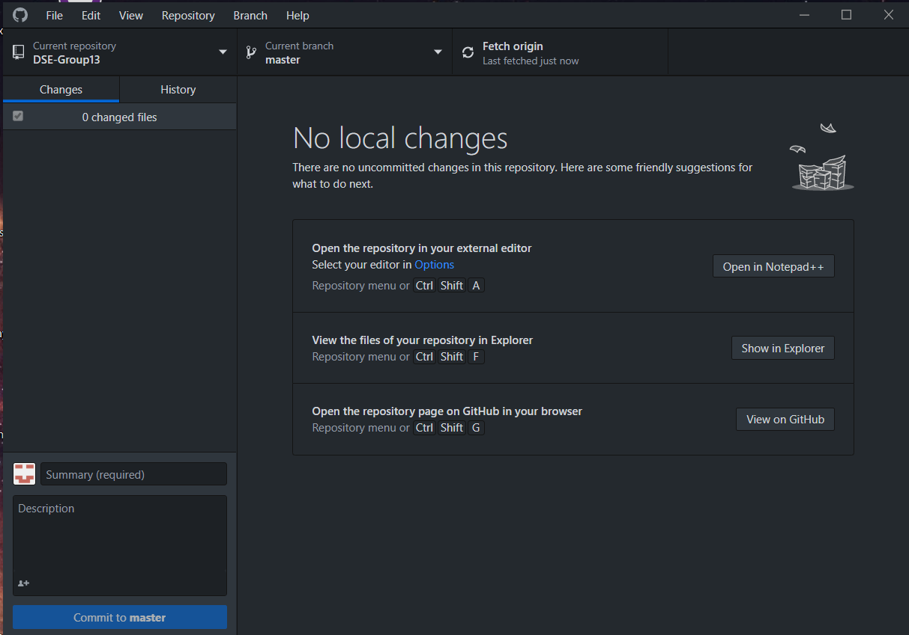
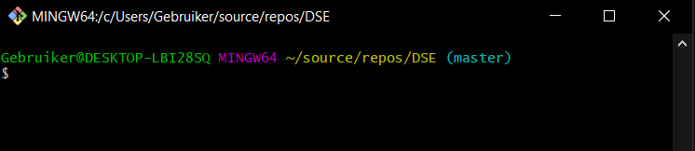
Collaborative Coding
How to use Git
Git bash
Git desktop
(Visual Studio github extention)

Slide 10
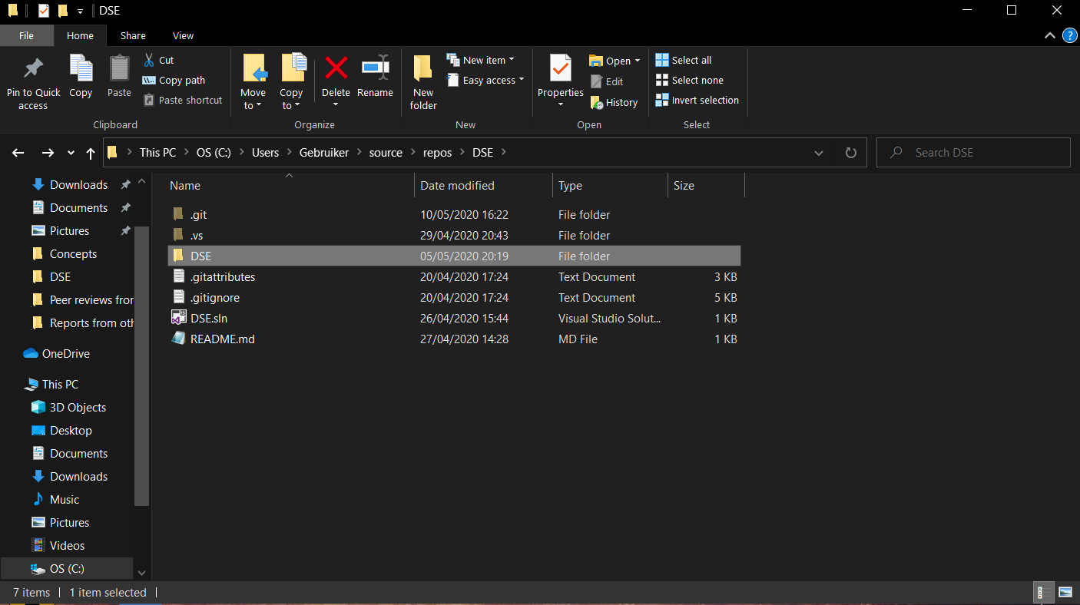
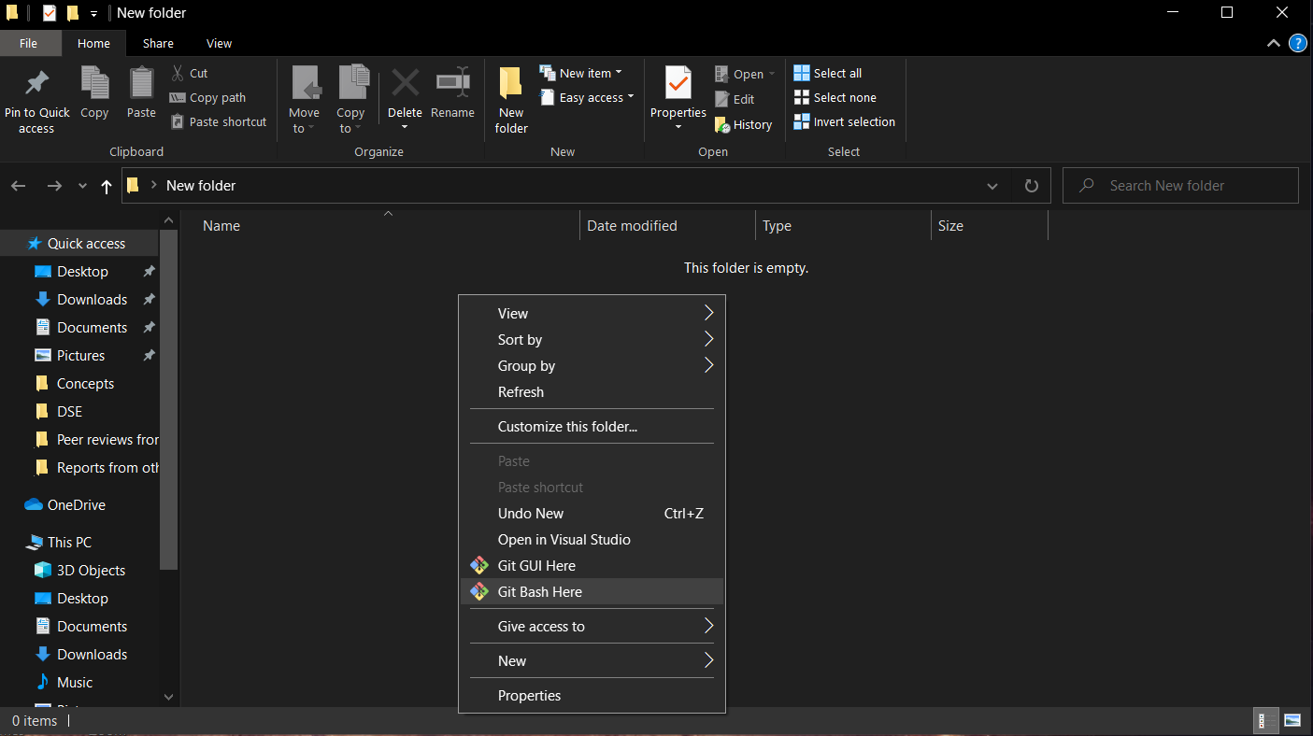
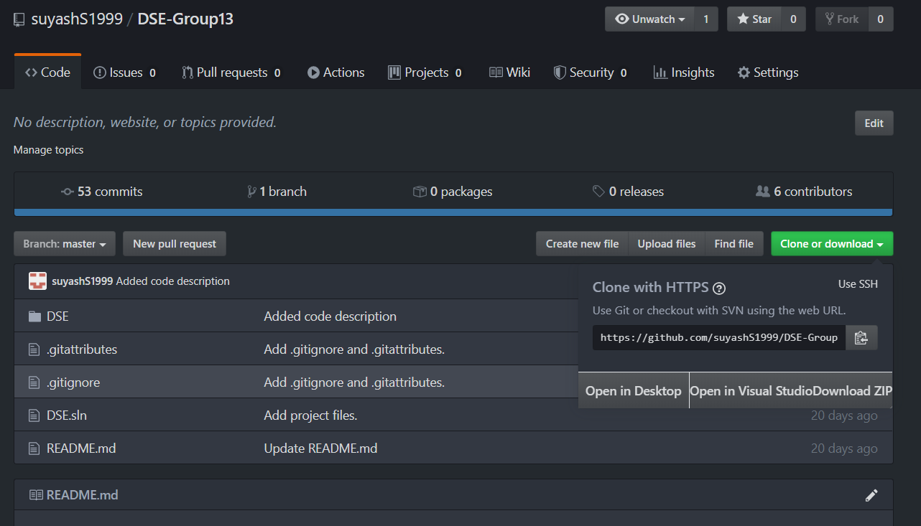
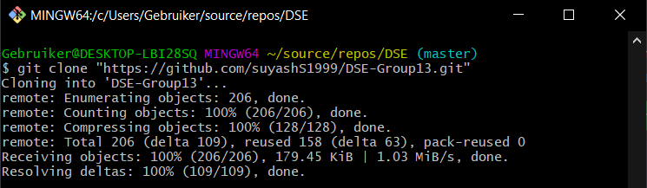
Collaborative Coding
How to clone repos

Slide 11
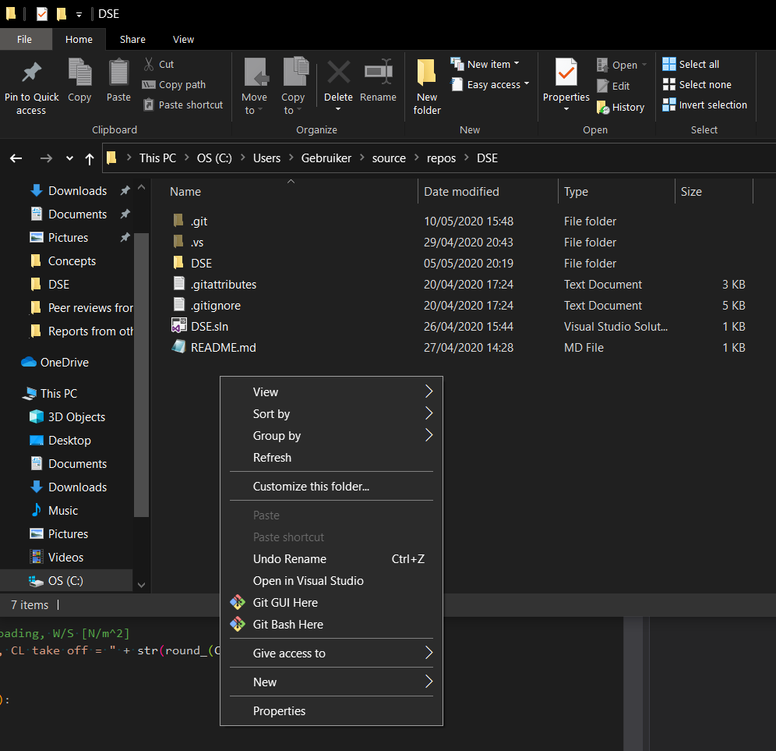
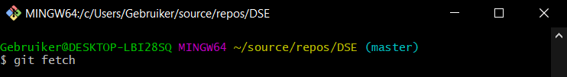
Collaborative Coding
How to Fetch/Pull (Git bash)
Always Pull before editing (and before committing)

Slide 12
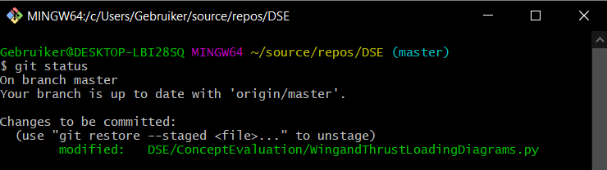
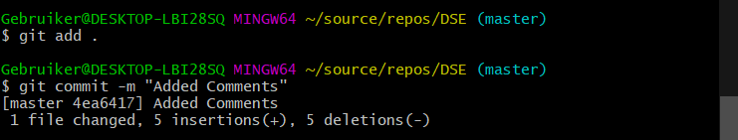
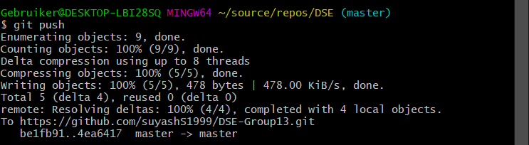
Collaborative Coding
How to Commit/Push (Git bash)

Slide 13
Collaborative Coding
How to Fetch/Pull (Git desktop)

Slide 14
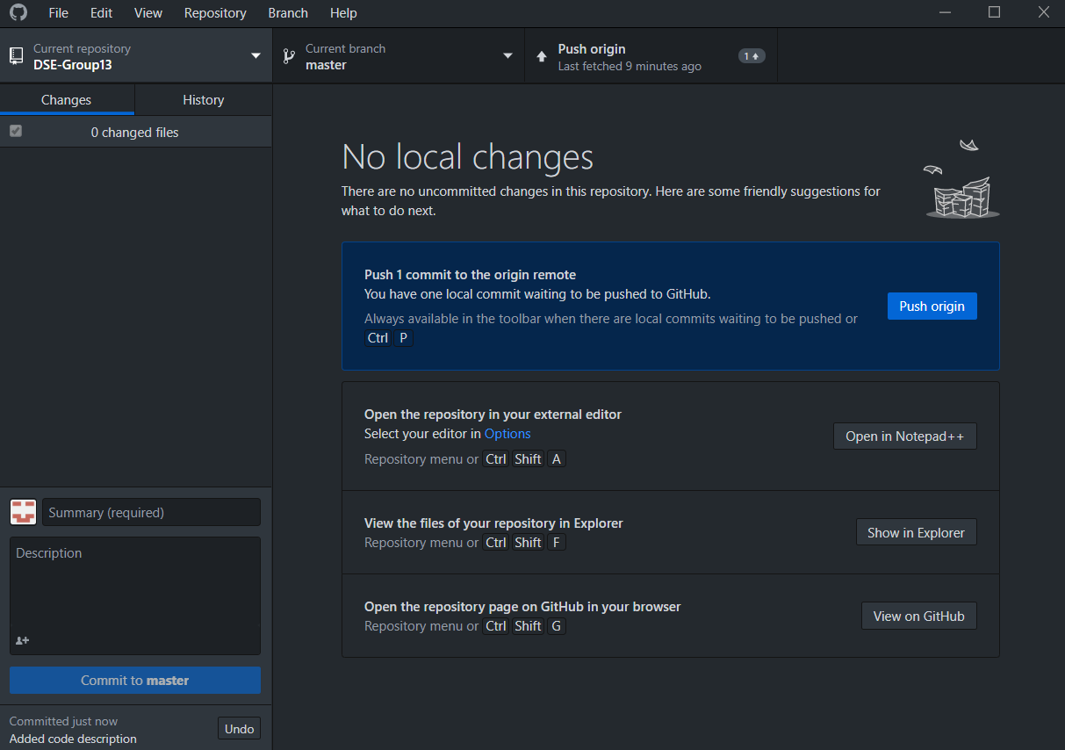
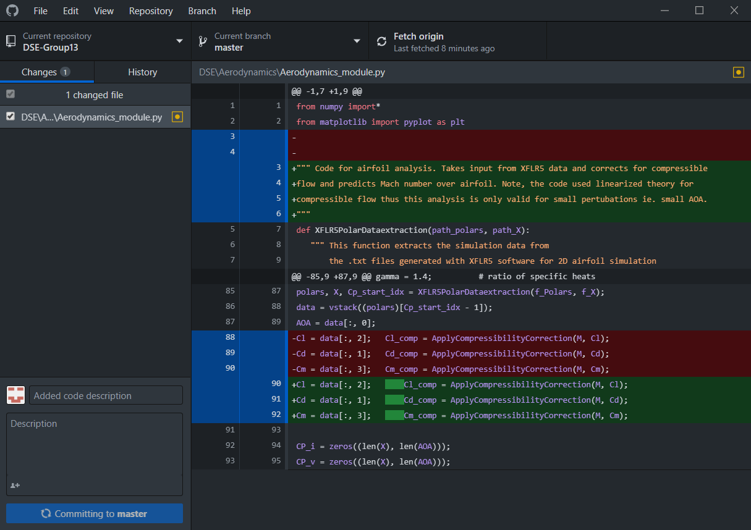
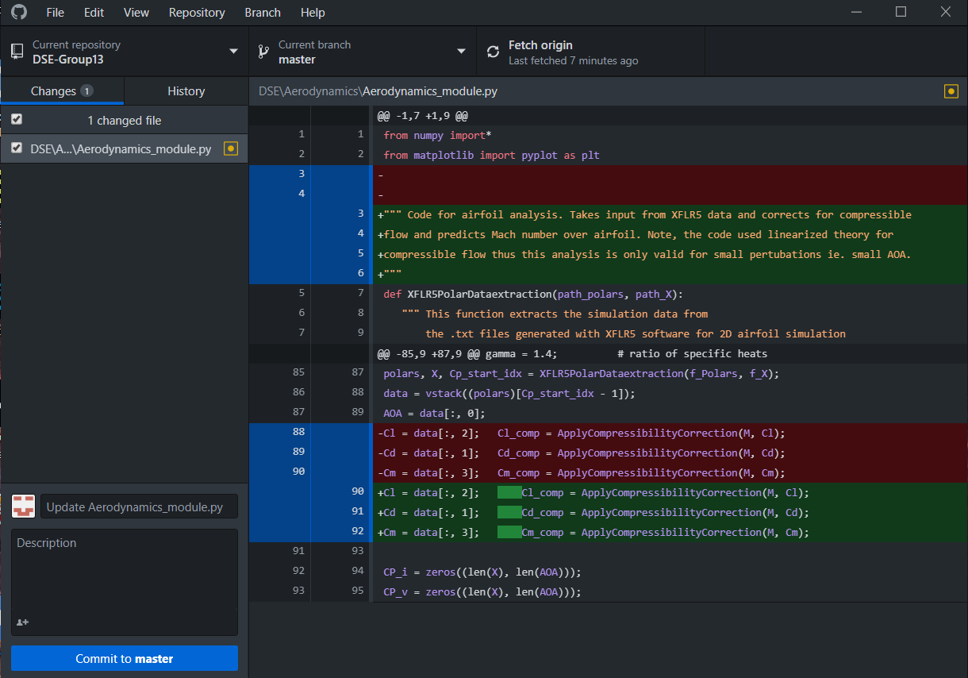
Collaborative Coding
How to Commit/Push(Git desktop)

Slide 15
Collaborative Coding
Always Pull before editing
or committing!!
Version Conflicts
When do they happen?
When 2 or more people edit the same Line Of Code!

Slide 16
Collaborative Coding
FAQ and Common fears:
If I pull, will my changes be overwritten?
NO. Git will merge your changes
Can I undo my commit?
Yes, but let me know of it

Slide 17
Summary
Use Python 3 in IDE of preference
Comment your code and make it readable
Using Git, Fetch/Pull and Commit/Push
Always Pull before editing or committing!!

Slide 18
Questions?

